Slide 1


Conditional Probability
Sometimes our computation of the probability of an event is changed by the knowledge that a related event has occurred (or is guaranteed to occur) or by some additional conditions imposed on the experiment.

Slide 2

Conditional probability
P(A | B) indicates the probability of event ‘A’ happening given that event B happened.

Slide 3
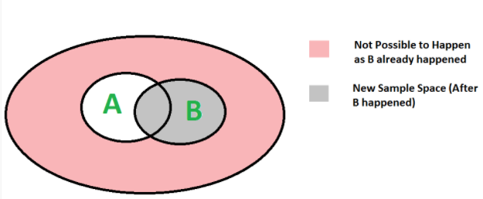
We can easily understand the formula for conditional probability using the below diagram.
Since B has already happened, the sample space reduces to B. So the probability of A happening becomes $\left.P(A∩B\right)$ divided by P(B)

Slide 4
Example: In a batch, there are 80% C programmers, and 40% are Java and C programmers. What is the probability that a C programmer is also Java programmer?
Solution:

Slide 5
Example: The probability that an automobile being filled with gasoline needs an oil change is 0.25; the probability that it also needs a new oil filter is 0.40; and the probability that both the oil and the filter need changing is 0.14. If the oil has to be changed, what is the probability that a new oil filter is need
Answer: 0.56

Slide 6
Example. Roll a die Let A = {score an even number} and B = {score a number ≥ 3}.
Find P(A/B) and P(B/A).

Slide 7
Let P(E) denote the probability of the event E. Given P(A) = 1, P(B) = 1/2, the values of P(A | B) and P(B | A) respectively are (A) 1/4, 1/2 (B) 1/2, 1/14 (C) 1/2, 1 (D) 1, ½
Answer: (D)

Slide 8
P and Q are considering to apply for job. The probability that p applies for job is 1/4. The probability that P applies for job given that Q applies for the job 1/2 and The probability that Q applies for job given that P applies for the job 1/3.The probability that P does not apply for job given that Q does not apply for the job . (A) 4/5 (B) 5/6 (C) 7/8 (D) 11/12
Answer: (A)

Slide 9
Law of Total Probability

Slide 10
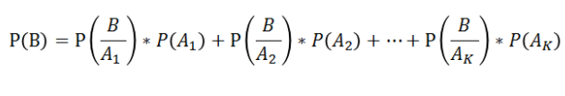
Given n mutually exclusive events $A_{1},A_{2},A_{3},....,A_{k}$such that their probabilities sum is unity and their union is the event space E, then $A_{i}$ ∩ $A_{j}$= NULL, for all i not equal to j,
and
$A_{1}∪A_{2}∪A_{3}∪....∪A_{k}$= E
Then Total Probability Theorem or Law of Total Probability is:
where B is an arbitrary event, and P(B/$A_{i}$) is the conditional probability of B assuming A already occured.

Slide 11
Note – The law of total probability is used when you don’t know the probability of an event, but you know its occurrence under several disjoint scenarios and the probability of each scenario.

Slide 12
Example – We draw two cards from a deck of shuffled cards with replacement. Find the probability of getting the second card a king.
Explanation – Let, A – represent the event of getting the first card a king. B – represent the event that the first card is not a king. E – represent the event that the second card is a king.
Then the probability that the second card will be a king or not will be represented by the law of total probability as:
P(E)= P(A)P(E|A) + P(B)P(E|B)

Slide 13
According to question:
P(A) = 4 / 52
P(E|A) = 4 / 52
P(B) = 48 / 52
P(E|B) = 4 / 52
Therefore,
P(E) = P(A)P(E|A) + P(B)P(E|B)
=(4 / 52) * (4 / 52) + (48 / 52) * (4 / 52)
= 0.0769230

Slide 14
Suppose that if I take bus 1, then I am late with probability 0.1. If I take bus 2, I am late with probability 0.2. The probability that I take bus 1 is 0.4, and the probability that I take bus 2 is 0.6. What is the probability that I am late?
Answer: 0.14

Slide 15
Example: In a certain library, twenty percent of the fiction books are worn and need replacement. Ten percent of the non-fiction books are worn and need replacement. Forty percent of the library’s books are fiction and sixty percent are non-fiction. What is the probability that a book chosen at random are worn?
Draw a tree diagram representing the data.
Solution: Let F represents fiction books and N represents non-fiction books. Let W represents worn books and G represents non-worn books.

Slide 16
Baye’s Theorem
The formula provides the relationship between P(A|B) and P(B|A).

Slide 17
Bayes’s formula
$$P(A|B)=\frac{\left.P(B|A)P(A\right)}{\left.P(B\right)}$$

Slide 18
Example A company buys 70% of its computers from company X and 30% from company Y. Company X produces 1 faulty computer per 5 computers and company Y produces 1 faulty computer per 20 computers. A computer is found faulty what is the probability that it was bought from company X?

Slide 19
Example Toss a coin 5 times. Let H₁ = ‘first toss is heads’ and let H_{A} = ‘all 5 tosses are heads’. Then P(H₁|H_{A}) = 1 but P(H_{A}|H₁) = 1/16

Slide 20
GATE-CS-2005
Box P has 2 red balls and 3 blue balls and box Q has 3 red balls and 1 blue ball. A ball is selected as follows:
Select a box
Choose a ball from the selected box such that each ball in the box is equally likely to be chosen. The probabilities of selecting boxes P and Q are (1/3) and (2/3), respectively.
Given that a ball selected in the above process is a red ball, the probability that it came from the box P is
(A) 4/19 (B) 5/19 (C) 2/9 (D) 19/30
Answer: (A)

Slide 21
Random Variable

Slide 22
Random variable is basically a function which maps from the set of sample space to set of real numbers.
Example : Suppose that two coins (unbiased) are tossed
X = number of heads.
[X is a random variable or function]
Here, the sample space
S = {HH, HT, TH, TT}.
The output of the function will be :
X(HH) = 2
X(HT) = 1
X(TH) = 1
X(TT) = 0

Slide 23
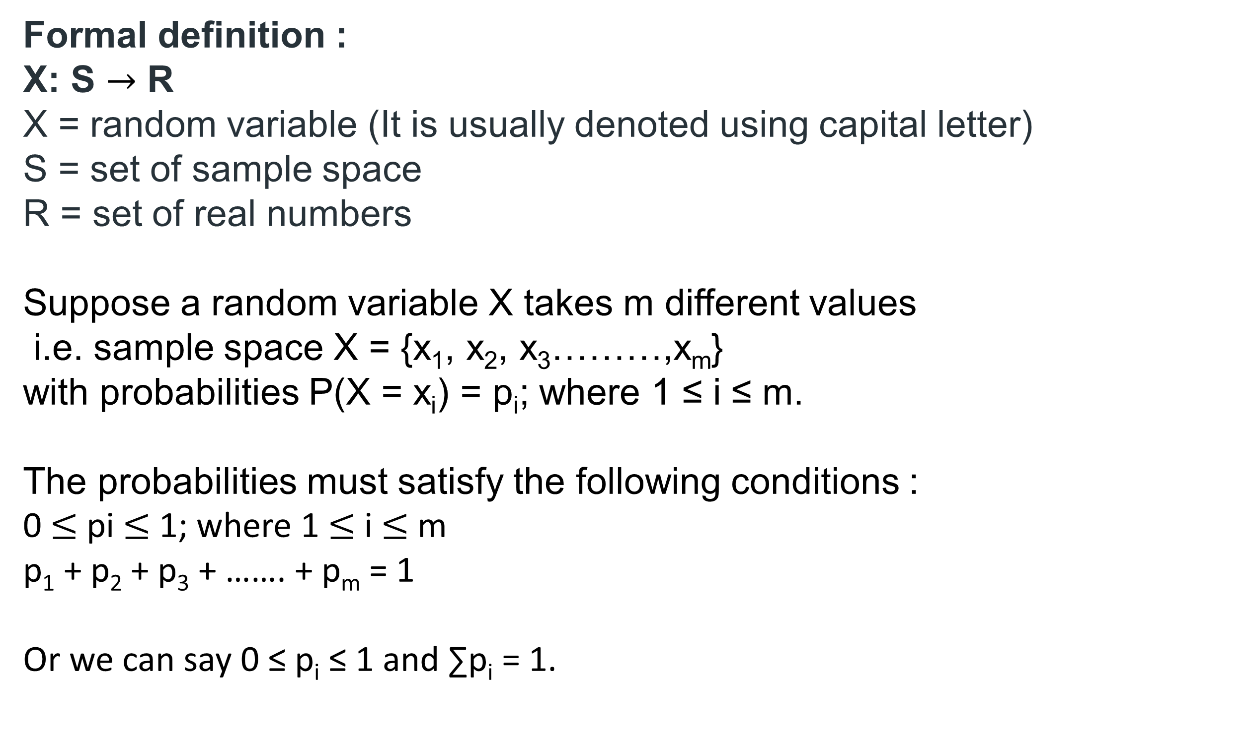
Formal definition : X: S $→$ R X = random variable (It is usually denoted using capital letter) S = set of sample space R = set of real numbers
Suppose a random variable X takes m different values
i.e. sample space X = {x₁, x₂, x₃………,x_{m}}
with probabilities P(X = x_{i}) = p_{i}; where 1 ≤ i ≤ m.
The probabilities must satisfy the following conditions :
0 $≤$ pi $≤$ 1; where 1 $≤$ i $≤$ m
p₁ + p₂ + p₃ + ……. + p_{m} = 1
Or we can say 0 ≤ p_{i} ≤ 1 and ∑p_{i} = 1.

Slide 24
Example : Suppose that two coins (unbiased) are tossed
X = number of heads.
Hence possible values for random variable X are 0, 1, 2. X = {0, 1, 2}
P(X=0) = probability that number of heads is 0
= P(TT) = 1/2*1/2 = 1⁄4.
P(X=1) = probability that number of heads is 1
= P(HT | TH) = 1/2*1/2 + 1/2*1/2 = 1⁄2.
P(X=2) = probability that number of heads is 2
= P(HH) = 1/2*1/2 = 1⁄4.

Slide 25
Example : Suppose a dice is thrown X = outcome of the dice.
Here, the sample space S = {1, 2, 3, 4, 5, 6}.
The output of the function will be:
P(X=1) = 1/6
P(X=2) = 1/6
P(X=3) = 1/6
P(X=4) = 1/6
P(X=5) = 1/6
P(X=6) = 1/6

Slide 26
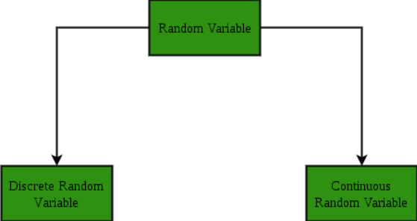

Slide 27

Discrete Random Variable:
A random variable X is said to be discrete if it takes on finite number of values.
The probability distribution of a discrete random variable X lists the values and their probabilities.
where 0 ≤ p_{i} ≤ 1 and ∑p_{i} = 1

Slide 28
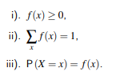
Probability Mass Function (PMF)
The probability function associated with it is said to be PMF = Probability mass function.
The set of ordered pairs (x, f(x)) is a probability function, probability mass function, or probability distribution of the discrete random variable X if, for each possible outcome x,

Slide 29
Example : PMF of getting number of heads when two coins (unbiased) are tossed

Slide 30

Example: Find a formula for the probability distribution of the total number of heads obtained in four tosses of a balanced coin.

Slide 31
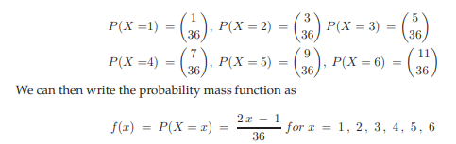
Example: Roll a red die and a green die. Let the random variable be the larger of the two numbers if they are different and the common value if they are the same. There are 36 points in the sample space

Slide 32

Example:- Let S = {0, 1, 2}
Find the value of P (X=0):
Sol:- We know that sum of all probabilities is equals to 1.
$⇒$p₁ + p₂ + p₃ = 1 $⇒$ p₁ + 0.3 + 0.5 = 1 $⇒$ p₁ = 0.2

Slide 33
Cumulative Density function (Discrete)
For a discrete random variable, the CDF is calculated as the sum of the probabilities of all values less than or equal to x. Formally, for a discrete random variable X, the CDF is defined as:
F(x) = P(X ≤ x) = ∑ P(X = k), for all k ≤ x
where P(X = k) is the probability that the random variable X takes on the value k, and the sum is taken over all values of k less than or equal to x.
Notes:
(I will give a brief about these points)

Slide 34
Let's consider a discrete random variable X that represents the outcome of rolling a fair six-sided die. The possible values of X are 1, 2, 3, 4, 5, and 6, each with a probability of 1/6.
The probability mass function (PMF) of X is given by:
P(X = 1) = 1/6
P(X = 2) = 1/6
P(X = 3) = 1/6
P(X = 4) = 1/6
P(X = 5) = 1/6
P(X = 6) = 1/6
Notes:
(I will give a brief about these points)

Slide 35
To calculate the CDF for a specific value of x, we can sum the probabilities of all values less than or equal to x.
For example, to calculate F(3), the CDF at x = 3, we sum the probabilities of X taking on the values 1, 2, and 3:
F(3) = P(X ≤ 3) = P(X = 1) + P(X = 2) + P(X = 3) = 1/6 + 1/6 + 1/6 = 1/2
So, the CDF at x = 3 is 1/2, which means there is a 50% chance that the outcome of rolling the die will be 3 or less
Notes:
(I will give a brief about these points)

Slide 36
Question Consider a population with four individuals, three of whom are female, denoted respectively by A, B, C, D where A is a male and the others are females. Then consider drawing two from this population.
And Let the random variable X represents number of females .
Then find the cdf.
Notes:
(I will give a brief about these points)

Slide 37
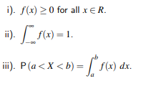
Continuous Random Variable:
A random variable X is said to be continuous if it takes on infinite number of values.
The probability function associated with it is said to be PDF = Probability density function
The function f(x) is a probability density function (pdf) for the continuous random variable X, defined over the set of real numbers, if

Slide 38
Example:- Compute the value of P (1 < X < 2).
Such that
$$f(x)=\left\{\begin{matrix}kx^{3}, 0≤x≤3 \\ 0, otherwise\end{matrix}\right.$$
Where, f(x) is a density function
Solution:- If a function f is said to be density function, then sum of all probabilities is equals to 1.
Since it is a continuous random variable, Integral value is 1 overall sample space.

Slide 39
Cumulative Density function (Continuous)
For a continuous random variable, the CDF is calculated by integrating the probability density function (PDF) of the random variable from negative infinity to x. Formally, for a continuous random variable X with PDF f(x), the CDF is defined as:
F(x) = P(X ≤ x) = $\int_{−∞}^{x}{f(t)dt}$, from negative infinity to x
where f(t) is the PDF of X, and the integral is taken from negative infinity to x.

Slide 40

Consider the density function
Find cdf.

Slide 41
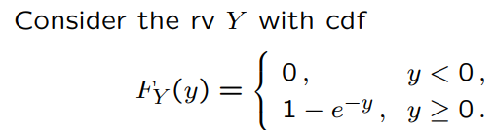
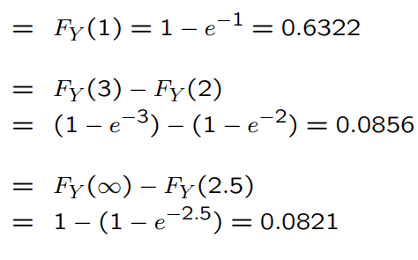
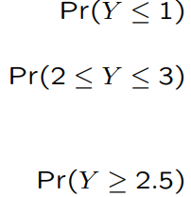

Slide 42
Find pdf

Slide 43
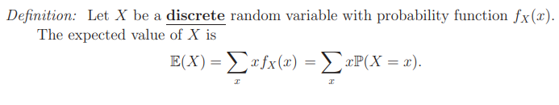
Expectation
The mean, expected value, or expectation of a random variable X is written as E(X) or µ_{X}
Notes:
Mean is expectation

Slide 44
A fair die with faces {1,2,3,4,5,6} is thrown repeatedly till ′3′ is observed for the first time. Let X denote the number of times the dice is thrown. The expected value of X is _______.
(GATE ECE 2015 Set 3)
5
6
10
15
Answer (b)

Slide 45
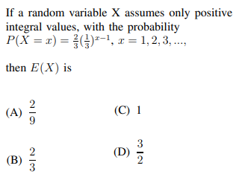

Slide 46
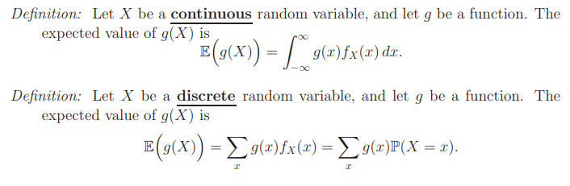
Notes:
Ex : No. of heads when I toss two coin simultaneously E(x^2)

Slide 47
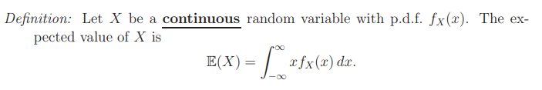
Expectation
The mean, expected value, or expectation of a random variable X is written as E(X) or µ_{X}

Slide 49
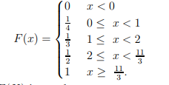
Let X be a random variable having the distribution function:
Then E(X) is equal to

Slide 50
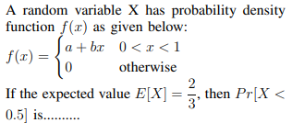

Slide 51

Thank you

